Slide 1

CS61B
Lecture 25: Advanced Trees
Tree Traversals
Level Order Traversal
Range Finding
Spatial (a.k.a. Geometric) Trees
Tree Iterators (Extra)

Slide 2
Traversals

Slide 3
Rooted Trees
We’ve used BSTS to build Maps and Sets, and Heaps to build a PQ.
… but trees are a more general concept.
skeleton
...
proj0
hw1
...
audio
data
synthesizer
spec
GuitarHeroLite.java
...
...
...
planets.txt
hw1.md
karplus-strong.png

Slide 4
Rooted Trees
Given such a tree, find how much disk space all the files use.
What one might call “tree iteration” is usually called “tree traversal.”
Unlike lists, there are many natural orderings.
skeleton
...
proj0
hw1
...
audio
data
synthesizer
spec
GuitarHeroLite.java
...
...
...
planets.txt
hw1.md
karplus-strong.png

Slide 5
Tree Traversal
Level Order
Traverse top-to-bottom, left-to-right (like reading in English):
We say that the nodes are ‘visited’ in the given order.
Depth First Traversals
Preorder, Inorder, Postorder
Basic (rough) idea: Traverse “deep nodes” (e.g. A) before shallow ones (e.g. F).
D
B
F
A
C
E
G

Slide 6
Depth First Traversals
Preorder: “Visit” a node, then traverse its children:
D
B
A
C
F
E
G
preOrder(BSTNode x) {
if (x == null) return; print(x.key) preOrder(x.left) preOrder(x.right) }
D
B
F
A
C
E
G

Slide 7
Depth First Traversals
Preorder traversal: “Visit” a node, then traverse its children: DBACFEG
Inorder traversal: Traverse left child, visit, then traverse right child:
A
B
C
D
E
F
G
preOrder(BSTNode x) {
if (x == null) return; print(x.key) preOrder(x.left) preOrder(x.right) }
inOrder(BSTNode x) {
if (x == null) return; inOrder(x.left) print(x.key)
inOrder(x.right) }
D
B
F
A
C
E
G

Slide 8
Depth First Traversals http://yellkey.com/top
Preorder traversal: “Visit” a node, then traverse its children: DBACFEG
Inorder traversal: Traverse left child, visit, traverse right child: ABCDEFG
Postorder traversal: Traverse left, traverse right, then visit: ???????
postOrder(BSTNode x) {
if (x == null) return; postOrder(x.left)
postOrder(x.right) print(x.key)
}
DBACEFG
GFEDCBA
GEFCABD
ACBEGFD
ACBFEGD
Other
D
B
F
A
C
E
G

Slide 9
Depth First Traversals
Preorder traversal: “Visit” a node, then traverse its children: DBACFEG
Inorder traversal: Traverse left child, visit, traverse right child: ABCDEFG
Postorder traversal: Traverse left, traverse right, then visit: ACBEGFD
postOrder(BSTNode x) {
if (x == null) return; postOrder(x.left)
postOrder(x.right) print(x.key)
}
DBACEFG
GFEDCBA
GEFCABD
ACBEGFD
ACBFEGD
Other
D
B
F
A
C
E
G

Slide 10
A Weird Trick
Preorder traversal: We walk the graph, from top going counter-clockwise. Shout every time we pass the LEFT of a node.
Inorder traversal: Shout when you cross the bottom.
Postorder traversal: Shout when you cross the right.
Example: Post-Order Traversal
4 7 8 5 2 9 6 3 1
1
2
3
4
5
6
7
8
9

Slide 11
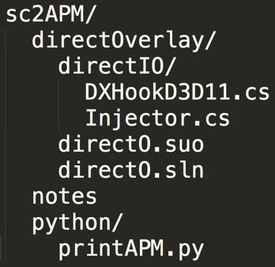
What Good Are All These Traversals?
Example: Preorder Traversal for printing directory listing:
sc2APM
directOverlay
notes
python
directIO
directO.suo
directO.sln
printAPM.py
DXHookD3D11.cs
Injector.cs

Slide 12
What Good Are All These Traversals?
Example: Postorder Traversal for gathering file sizes.
postOrder(BSTNode x) {
if (x == null) return 0; int total = 0;
for (BSTNode c : x.children()) total += postOrder(c) total += x.fileSize();
return total; }
sc2APM
324
directOverlay
notes
python
38912
881
874
directIO
directO.suo
directO.sln
printAPM.py
18381
8798
DXHookD3D11.cs
Injector.cs

Slide 13
What Good Are All These Traversals?
Example: Postorder Traversal for gathering file sizes.
postOrder(BSTNode x) {
if (x == null) return 0; int total = 0;
for (BSTNode c : x.children()) total += postOrder(c) total += x.fileSize();
return total; }
68170
sc2APM
66972
324
874
directOverlay
notes
python
27179
38912
881
874
directIO
directO.suo
directO.sln
printAPM.py
18381
8798
DXHookD3D11.cs
Injector.cs

Slide 14
Visitor Pattern (Patterns)
When writing general tree traversal code. Avoid rewriting traversal for every task of interest (print, sum filesizes, etc.) by using the Visitor pattern.
void preorderTraverse(Tree<Label> T, Action<Label> whatToDo) {
if (T == null) { return; }
whatToDo.visit(T); /* before we hard coded a print */
preorderTraverse(T.left, whatToDo);
preorderTraverse(T.right, whatToDo);
}
class FindPig implements Action<String> {
boolean found = false;
@Override
void visit(Tree<String> T) {
if ("pig".equals(T.label))
{ found = true; }
}
}
interface Action<Label> {
void visit(Tree<Label> T);
}
preorderTraverse(someTree, new FindPig());
The real visitor pattern is more complex.

Slide 15
Preorder Traversal Runtime: http://yellkey.com/most
What is the runtime of a preorder traversal in terms of N, the number of nodes? (in code below, assume the visit action takes constant time)
Θ(1)
Θ(log N)
Θ(N)
Θ(N log N)
Θ(2^{N})
k
e
v
b
g
p
y
a
d
f
j
m
r
x
z
void preorderTraverse(Tree<Label> T, Action<Label> whatToDo) {
if (T == null) { return; }
whatToDo.visit(T);
preorderTraverse(T.left, whatToDo);
preorderTraverse(T.right, whatToDo);
}

Slide 16
Preorder Traversal Runtime
What is the runtime of a preorder traversal in terms of N, the number of nodes? (in code below, assume the visit action takes constant time)
3. Θ(N) : Every node visited exactly once. Constant work per visit.
Runtime is exponential in height of the tree, not number of items.
Θ(2^{H}), but H = Θ(log N)
This is not a proof of runtime, but rather a response to a possible objection.
k
N = 15
H = 3
e
v
b
g
p
y
a
d
f
j
m
r
x
z

Slide 17
Level Order Traversal

Slide 18
Tree Traversal: Level Order Traversal
The Level Order Traversal is the result of reading the nodes “like a book”, one level at a time.
How would we implement a level order traversal?
Level order: D B F A C E G
Goal: Visit nodes on 0th level, then 1st level, then 2nd level, etc.
D
B
F
A
C
E
G

Slide 19
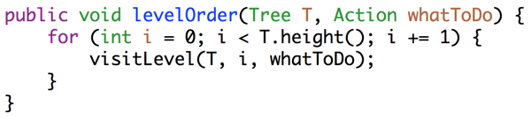
Level-Order Traversal through Iterative Deepening
public void levelOrder(Tree T, Action toDo) {
for (int i = 0; i < T.height(); i += 1) {
visitLevel(T, i, toDo);
}
}
D
B
F
A
C
E
G
public void visitLevel(Tree T, int level, Action toDo) {
if (T == null)
{ return; }
if (lev == 0)
{ toDo.visit(T.key); }
else {
visitLevel(T.left(), lev - 1, toDo);
visitLevel(T.right(), lev - 1, toDo);
}
}
Run visitLevel H times, one for each level.
The strategy described on this slide is called “Iterative Deepening”.

Slide 20
Level-Order Traversal through Iterative Deepening
0
1
2
0
1
0
1
Partially completed Iterative Deepening,
0
0
0

Slide 21
Iterative Deepening Runtime: http://yellkey.com/nor
What is the runtime to complete iterative deepening on a complete tree (as shown below) as a function of node count N?
Θ(log N)
Θ(N)
Θ(N log N)
Θ(N²)
Θ(2^{N})
0
1
2
3
0
1
0
1
2
2
0
1
0
1
0
1
0
1
0
0
0
0
0
0
0
0

Slide 22
Preorder Traversal and Prefix Expressions
What is the runtime to complete iterative deepening on a complete tree (as shown below) as a function of node count N?
Θ(N)
k
e
v
b
g
p
y
a
d
f
j
m
r
x
z
Top level considered: 1
Then top two levels considered: 1 + 2 = 3
Then top three levels considered: 1 + 2 + 4 = 7
Then top four: 1 + 2 + 4 + 8 = 15
Top H levels: 2¹+2²+2³+...+2^{H} - H = Θ(N)
Note: Exact sum doesn’t matter, the order of growth (and hence the pattern) is what is important.
Interesting aside: Much harder to solve as “4 visits at level 0” then “6 visits at level 1”, etc.

Slide 23
Iterative Deepening Runtime: http://yellkey.com/work
What is the runtime for iterative deepening on a “spindly” tree?
Θ(log N)
Θ(N)
Θ(N log N)
Θ(N²)
Θ(2^{N})
k
v
y
z

Slide 24
Iterative Deepening Runtime
What is the runtime for iterative deepening on a “spindly” tree?
Θ(N²)
Top level considered: 1
Then top two levels: 1 + 1 = 2
Then top three levels: 1 + 1 + 1 = 3
Top H levels: H
Total: 1 + 2 + 3 + … + H = H²
H = N - 1, so Θ(N²)
k
v
y
z

Slide 25
Tree Height
For algorithms whose runtime depends on height, difference between bushy tree and spindly tree can be huge!
H = Θ(log(N))
H = Θ(N)
Iterative deepening runtimes: Θ(N) vs. Θ(N²)
Note: No simple mapping from height to runtime.
Extra for experts: Write a better level order Traversal algorithm.

Slide 26
Range Finding

Slide 27
Geometric Search
Suppose we want an operation that returns all items in a range:
public Set<Label> findInRange(Tree T, Label min, Label max)
Example:
findInRange(T, “dog”, “elves”)
Should return:
{“dog”, “elf”}
dog
bag
flat
alf
cat
elf
glut
eyes

Slide 28
Geometric Search
Easy approach, just do a traversal of the whole tree, and use visitor pattern to collect matching items.
Runtime is Θ(N)
class rangeFind implements Action<String> {
private Label min, max;
public Set<Label> inRange;
public rangeFind(Label min, Label max) {
this.min = min; this.max = max;
inRange = new HashSet<Label>();
}
void action(Tree<Label> T) {
if (T.label ≼ max && T.label ≽ min) {
inRange.add(T.label);
}
}
}

Slide 29
Geometric Search
Suppose we want an operation that returns all items in a range:
public Set<Label> findInRange(Tree T, Label min, Label max)
Can avoid need to traverse entire tree by being clever.
Example:
findInRange(T, “dog”, “elves”)
No need to look:
Left of dog.
Right of flat.
dog
bag
flat
alf
cat
elf
glut
eyes
Nodes inspected: dog, flat, elf, eyes
Nodes matching: dog, elf

Slide 30

Pruning and findInRange Runtime
Suppose we want an operation that returns all items in a range:
public Set<Label> findInRange(Tree T, Label min, Label max)
Pruning: Restricting our search to only nodes that might contain the answers we seek.
dog
bag
flat
alf
cat
elf
glut
eyes
Nodes inspected: dog, flat, elf, eyes
Nodes matching: dog, elf

Slide 31
Pruning and findInRange Runtime
Suppose we want an operation that returns all items in a range:
public Set<Label> findInRange(Tree T, Label min, Label max)
Pruning: Restricting our search to only nodes that might contain the answers we seek.
Runtime for our search: Θ(log N + R)
N: Total number of items in tree.
R: Number of matches.
See study guide A-level problems for proof.
dog
bag
flat
alf
cat
elf
glut
eyes
Nodes inspected: dog, flat, elf, eyes
Nodes matching: dog, elf

Slide 32
Spatial Trees

Slide 33

2D Range Finding
Suppose we want to do range finding on Planets in space.
Query: How many objects are in the highlighted rectangle?
Could iterate through all objects in Θ(N) time.
But could we do some sort of tree + pruning?
Pruning implies we need some kind of tree, but ...

Slide 34
Building Trees of Two Dimensional Data
So far, we’ve only considered one dimensional data.
There exists a total order!
5 < 10
“alf” < “elf”
Some data is two dimensional, e.g. the location of Planets.
earth.xPos = 1.5, earth.yPos = 1.6
mars.xPos = 1.0, mars.yPos = 2.8
If we’re comparing by location:
In xPos, Mars < Earth
In yPos, Mars > Earth
(1.0, 2.8)
(1.5, 1.6)
1.5, 1.6
1.5, 1.6
1.0, 2.8
1.0, 2.8
X-Based Tree
Y-Based Tree

Slide 35
Handling Multidimensional Data: Quadtrees
Quadtrees:
Divide and conquer by splitting 2D space into four quadrants.
Store items into appropriate quadrant.
Repeat recursively if more than one item in a quadrant.
Definition, quadtree is either:
Empty
A ‘root’ item at some position (x, y) AND four quadtrees that are northwest, northeast, southwest, southeast of (x, y)
Use TWO compares to decide which direction to go.
NW
NE
A
SW
SE

Slide 36
Quadtree Demo
Below: Quadtree Representation of 5 objects in 2D space.
Demo: Link
A
NW
SW
B
NE
SE
(0, 1)
(2, 2)
B
E
C
SW
D
C
(1, 0)
A
(-1, -1)
SE
E
D
(-2, -2)

Slide 37
Quadtree Demo
Quadtrees allow us to prune when performing a rectangle search.
Basic rule: Prune a branch if the search rectangle doesn’t overlap a quadrant of potential interest.
A
NW
SW
E pruned, boxes do not intersect.
B
NE
SE
(0, 1)
(2, 2)
B
E
C
SW
D
C
(1, 0)
Box for E
A
(-1, -1)
SE
E
D
D pruned, boxes do not intersect.
(-2, -2)
Box for D
Only item that intersects box is B.

Slide 38
Optional: Tree Iterators

Slide 39
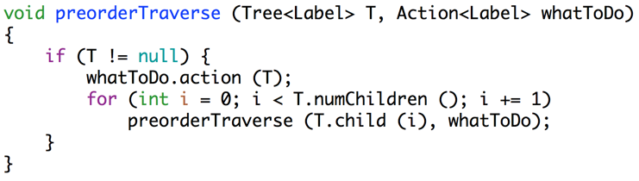
Iterators
Suppose we want to iterate through a tree using the : operator.
How can we adapt our traversal code to implement next() and hasNext()?

Slide 40
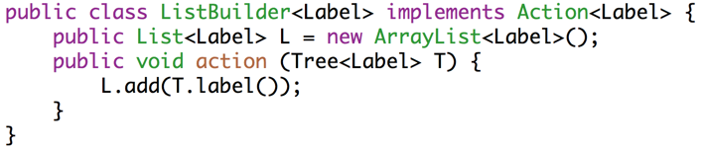
Iteration: The Obvious Way
One approach: Create an action class that puts visited item in a list.

Slide 41
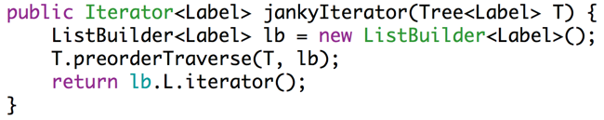
Iteration: The Obvious Way
One approach: Create an action class that puts visited item in a list.
iterator method creates such a list and returns an iterator to it.
What’s the downside of this solution?

Slide 42
Iteration: Space-saving Approach
Tricky question: How could convert our recursive traversal into iterative code using a stack?
Observation: Each call to preorderTraverse is the equivalent of putting a call on the call stack.

Slide 43
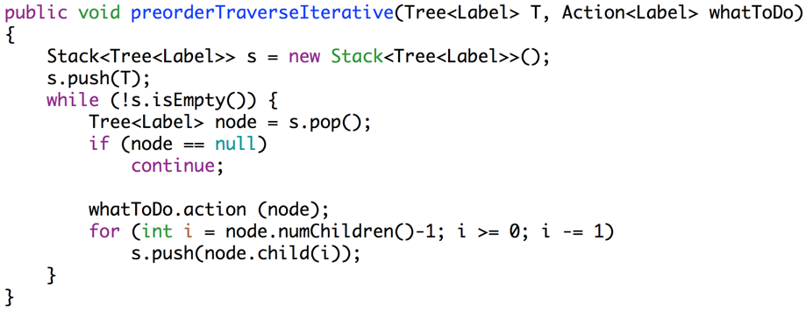
Iteration: Space-saving Approach
Tricky question: How could convert our recursive traversal into iterative code using a stack?
Observation: Each call to preorderTraverse is the equivalent of putting a call on the call stack.

Slide 44
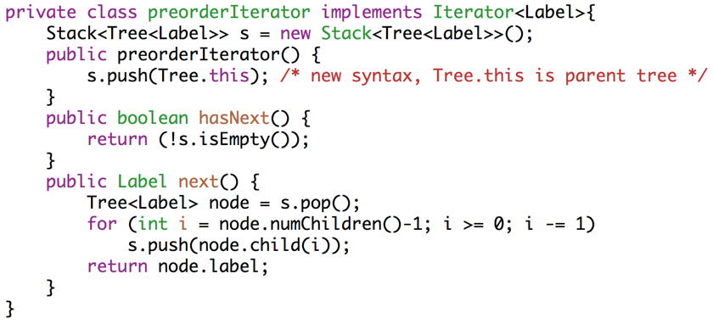
Iteration: Space-saving Approach
Use our stack-based approach, but use next() instead of looping.

Slide 45
Citations
Title figure: A thing I made (one of the first Java programs I wrote during my teaching career)
Pruning image: https://res.cloudinary.com/dc8hy36qb/image/upload/v1435213404/Fruit-Tree-Pruning-Methods_o7ieen_atkmmq.jpg
Jonathan Shewchuk: Nice intuitive use cases for various traversals.

